Slide 1



Resource Management Application
PTG – SFDC
August-2020
© 2020 YASH Technologies | www.yash.com | Confidential

Slide 2


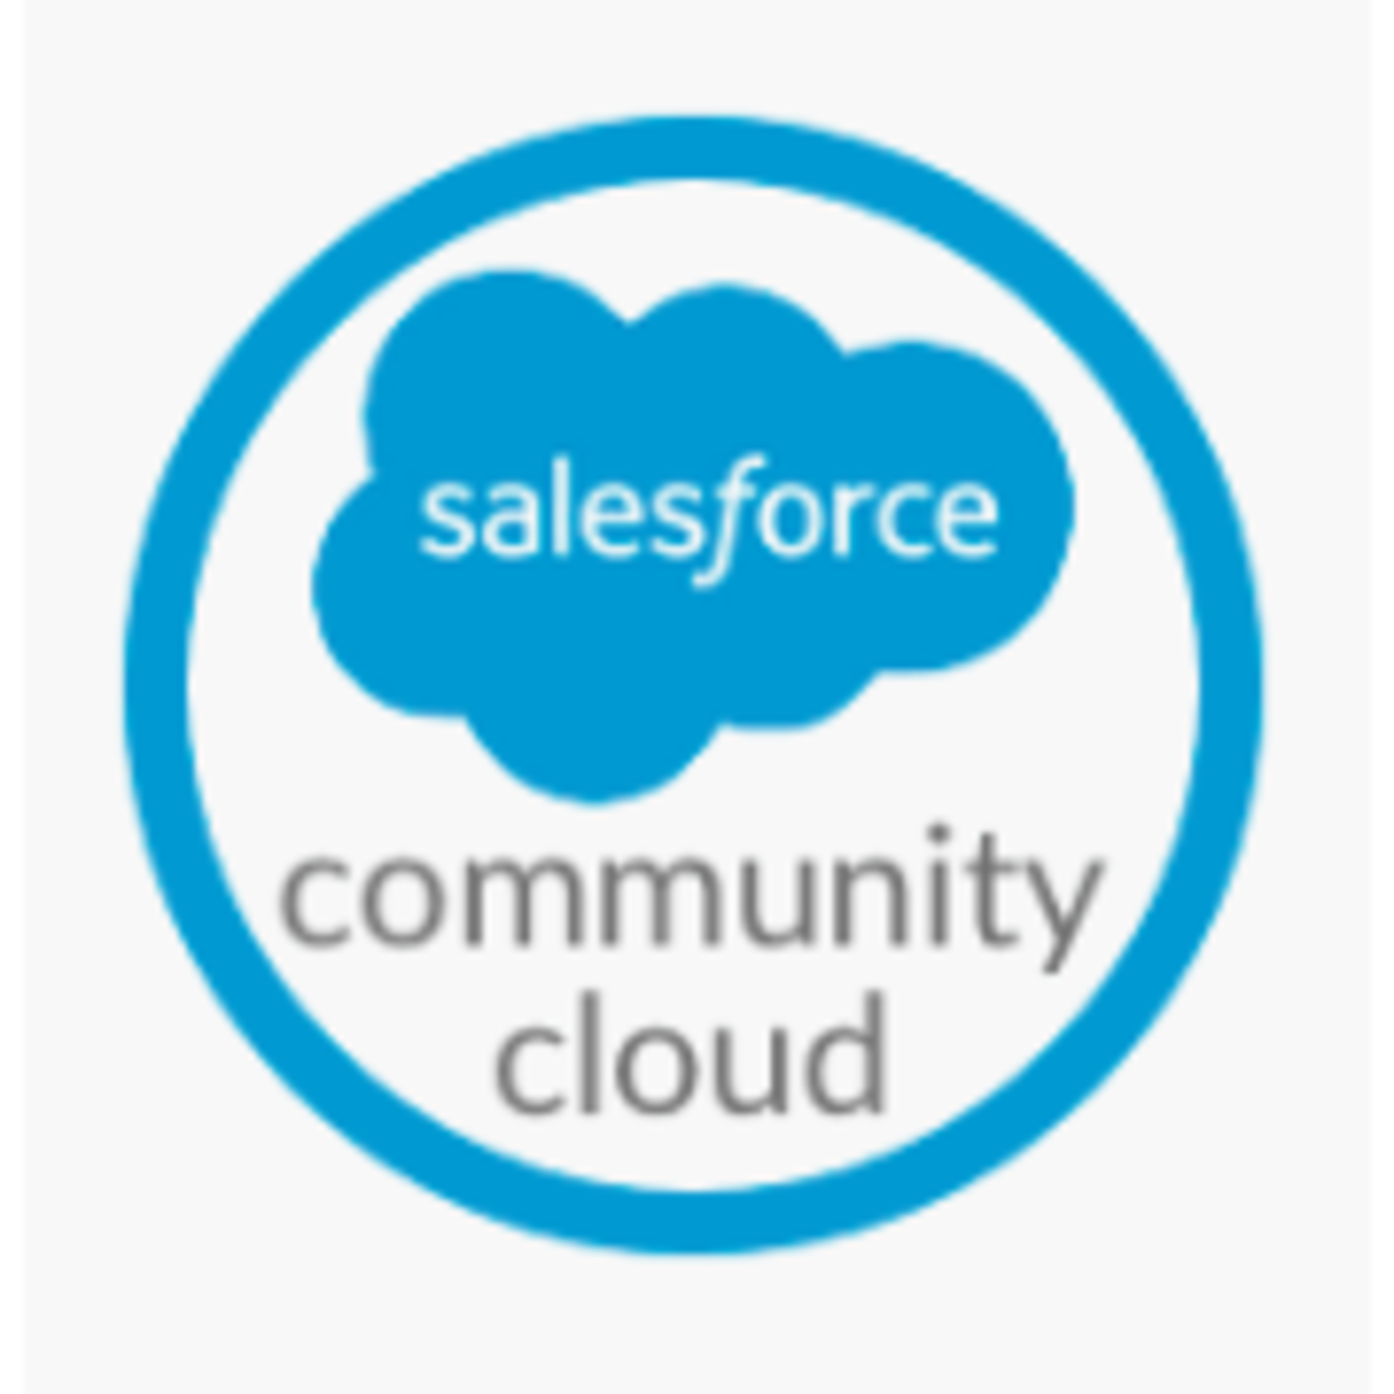

Resource Management Application
YASH Team has developed a community to manage the resources in an organization.
It is a platform where employees can easily suggest the project ideas. User with the higher authorities approves the idea if it is meeting organization standard. Once the idea is approved project gets created and employees with the same interest can start working on it. Application also helps to track the progress of project.
User with higher authorities can analyze the work using map functionality, Reports and dashboards.
Employees can collaborate on project using chatter.
Employees
Salesforce community
User with higher authorities

Slide 3
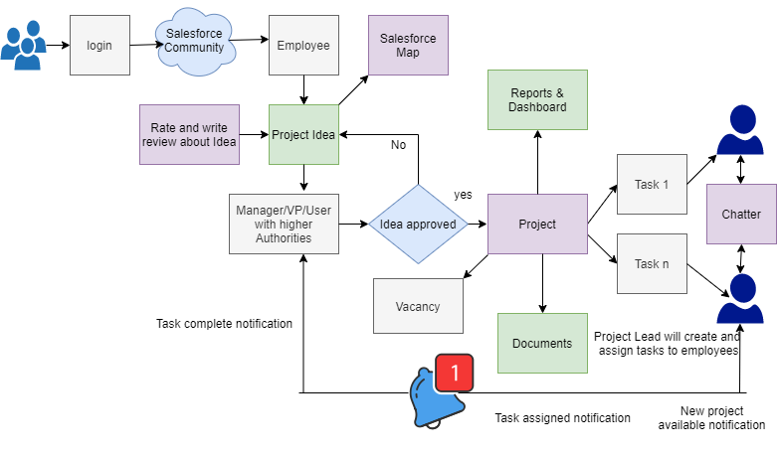
Architecture

Slide 4
THANK YOU
Shrilekha Pawar

